Slide 1


Slide 2

Ivaylo Papazov
  Senior Software Engineer at Payhawk
  Trainer at SoftUni 4+
  Experience with JS, React, Node.js, MongoDB
  6+ years professional experience

Slide 3
SSR the future of WEB?
Past, present and future

Slide 4


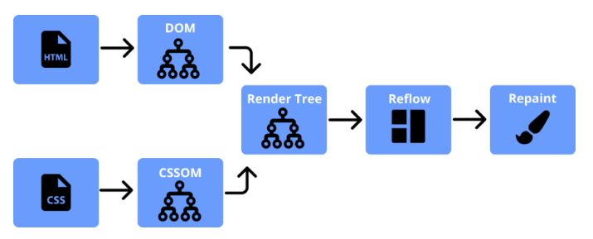
What is Rendering
Generation of visualization
Rendering Engines
Browser Rendering
HTML Generation

Slide 5
History of web, early years
1989
Tim Berners-Lee invented WWW
1990
First running web server
1993
HTML was created
1995
JavaScript was invented by Brendan Eich

Slide 6
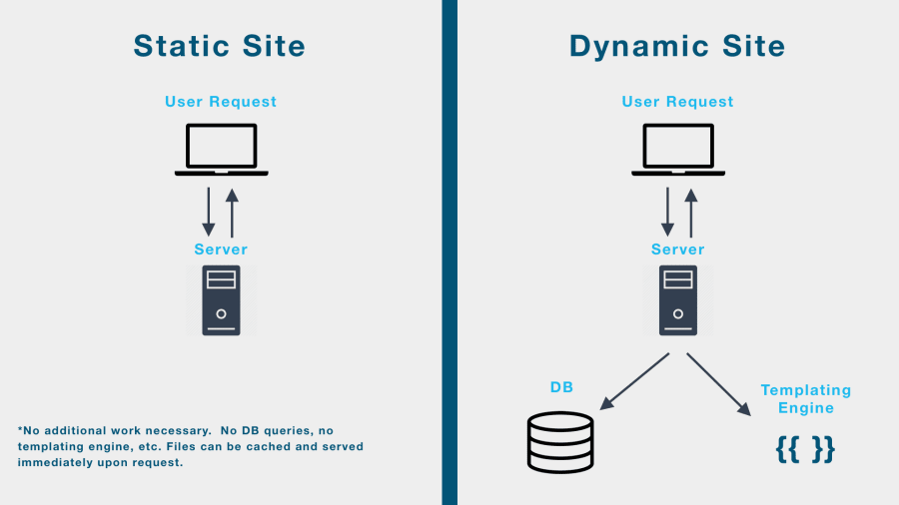

Slide 7
History of web, dawn of SPA
1996
CSS
1999
AJAX
2005
Google Maps
2006
jQuery

Slide 8
History of web, SPA Frameworks
2010
Angular 1
2013
React
2014
Vue
2016
Angular 2

Slide 9
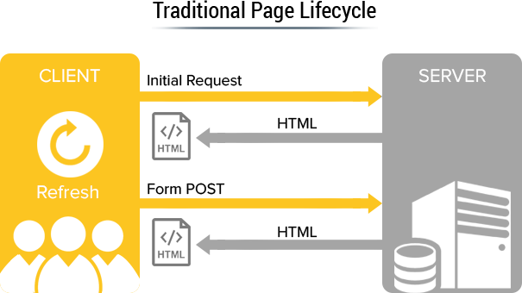
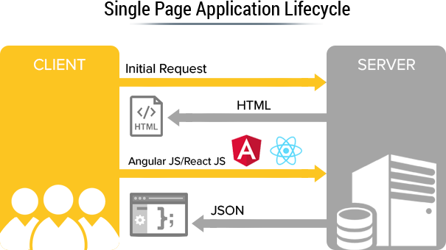

Slide 10
HTML Generation
Client Side Rendering
CSR
HTML is generated on the client during execution
Static Site Generation
SSG
HTML is prebuild on the server ahead of time
Server Side Rendering
SSR
HTML is generated on the server during execution

Slide 11
Client Side Rendering
Pros and cons
Great UX
No page reloads
High performance
No HTTP overhead
Rapid development
Easy hosting
cons
-
Initial loading
Slower devices
Caching
SEO
+
pros

Slide 12
Server Side Rendering
Server renders the SPA
Full page render
Hydrate html
Allow client side rendering

Slide 13
Do we need SSR?
App behind login
Internal system
Separate website
Disallow robots
SSR
+
Discoverable pages
Fast initial load
We care for SEO
Promote in social networks
+
CSR

Slide 14
SSR Strategies
ISR
Cloud
Pre-Rendering
Dynamic
Rendering
Server Rendering
Hybrid
Rendering

Slide 15
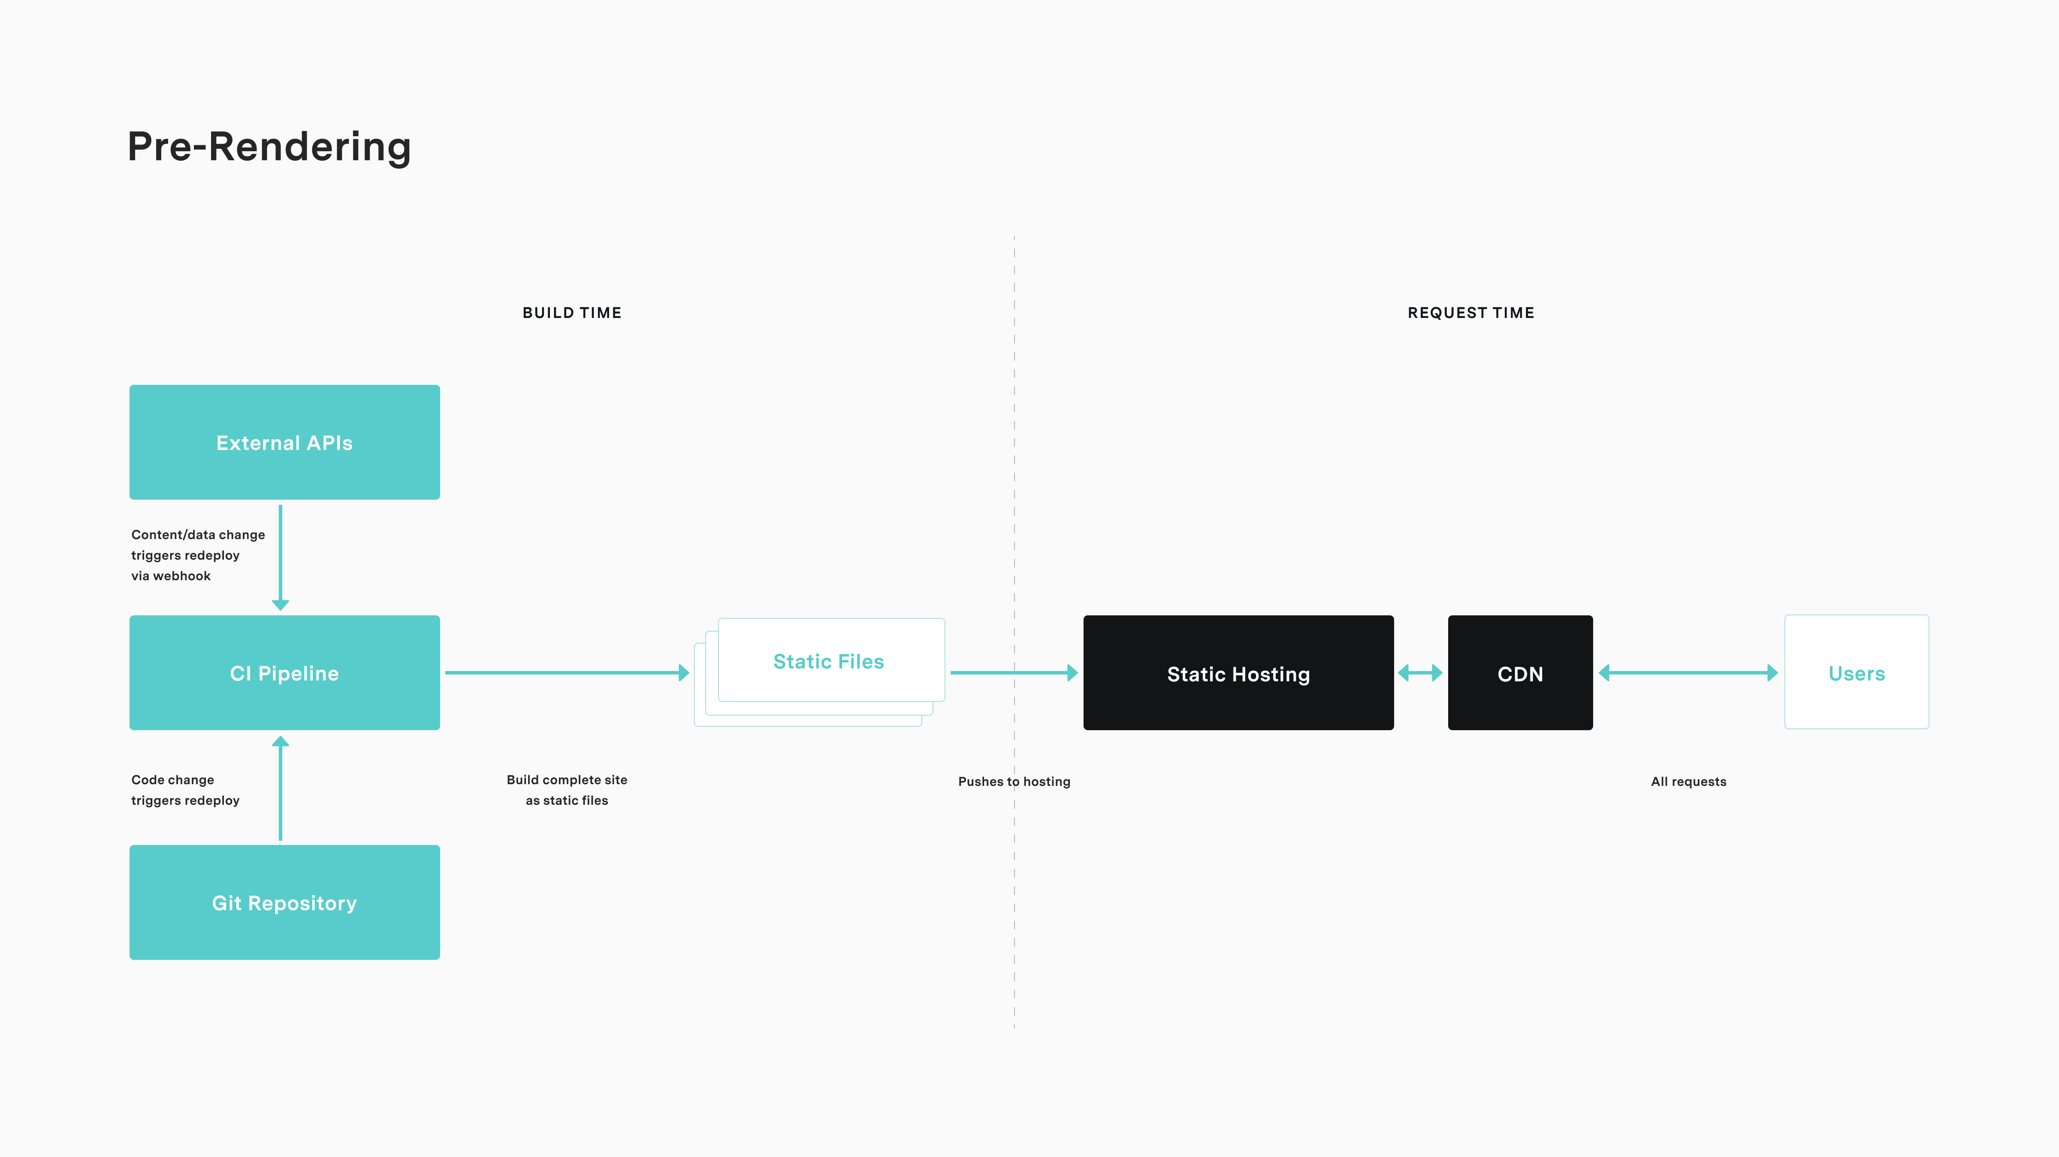

Slide 16
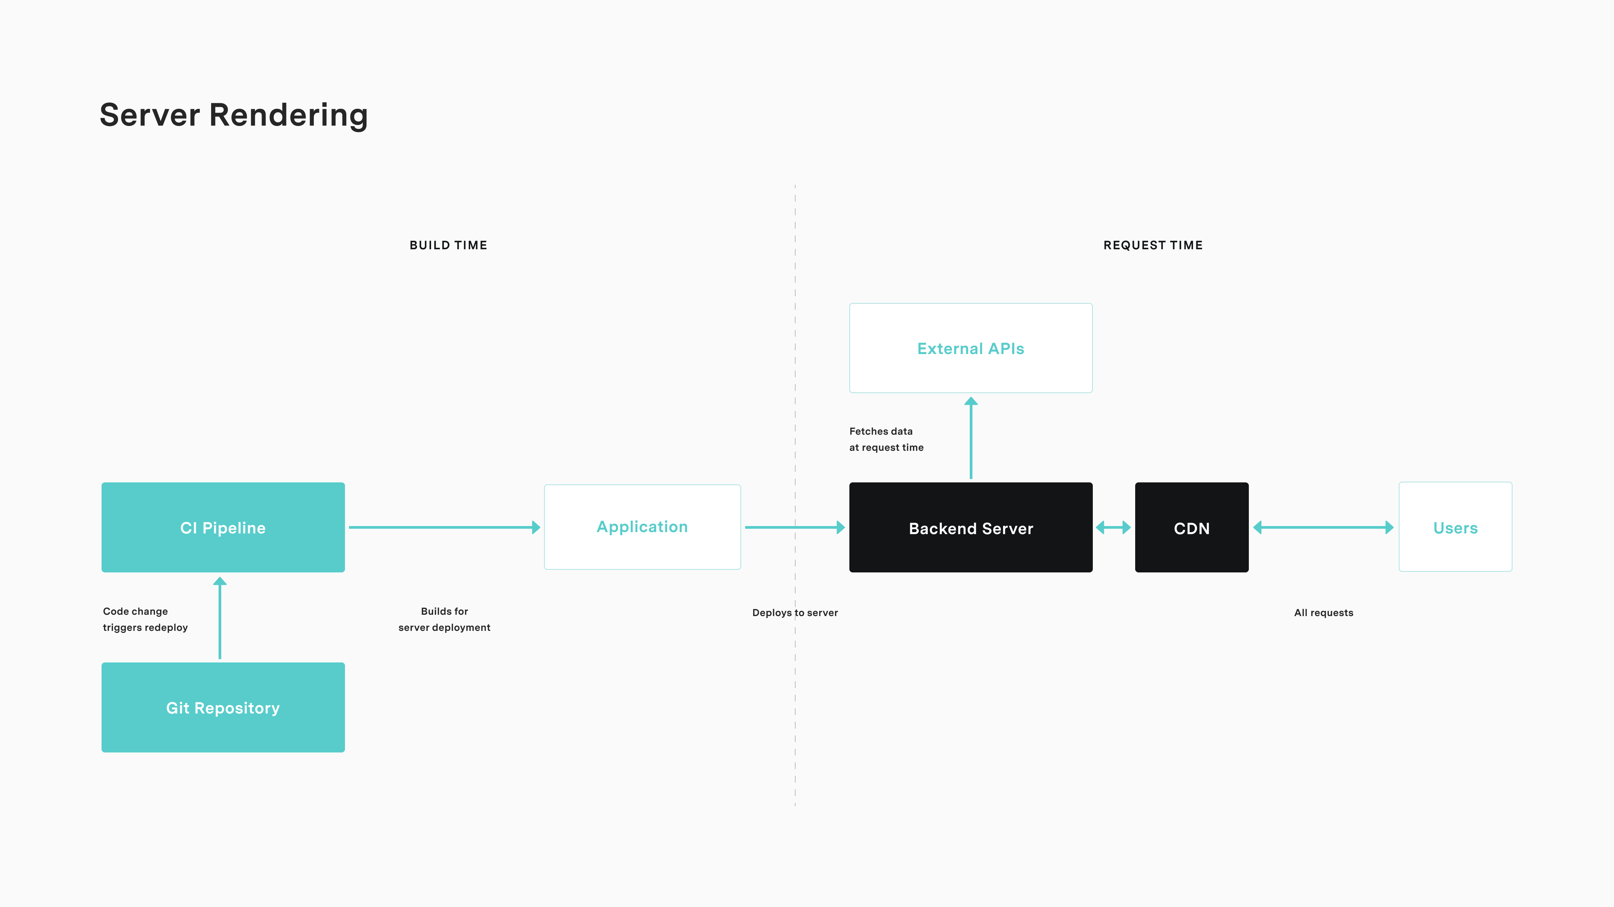
Custom Rendering

Slide 17


Slide 18
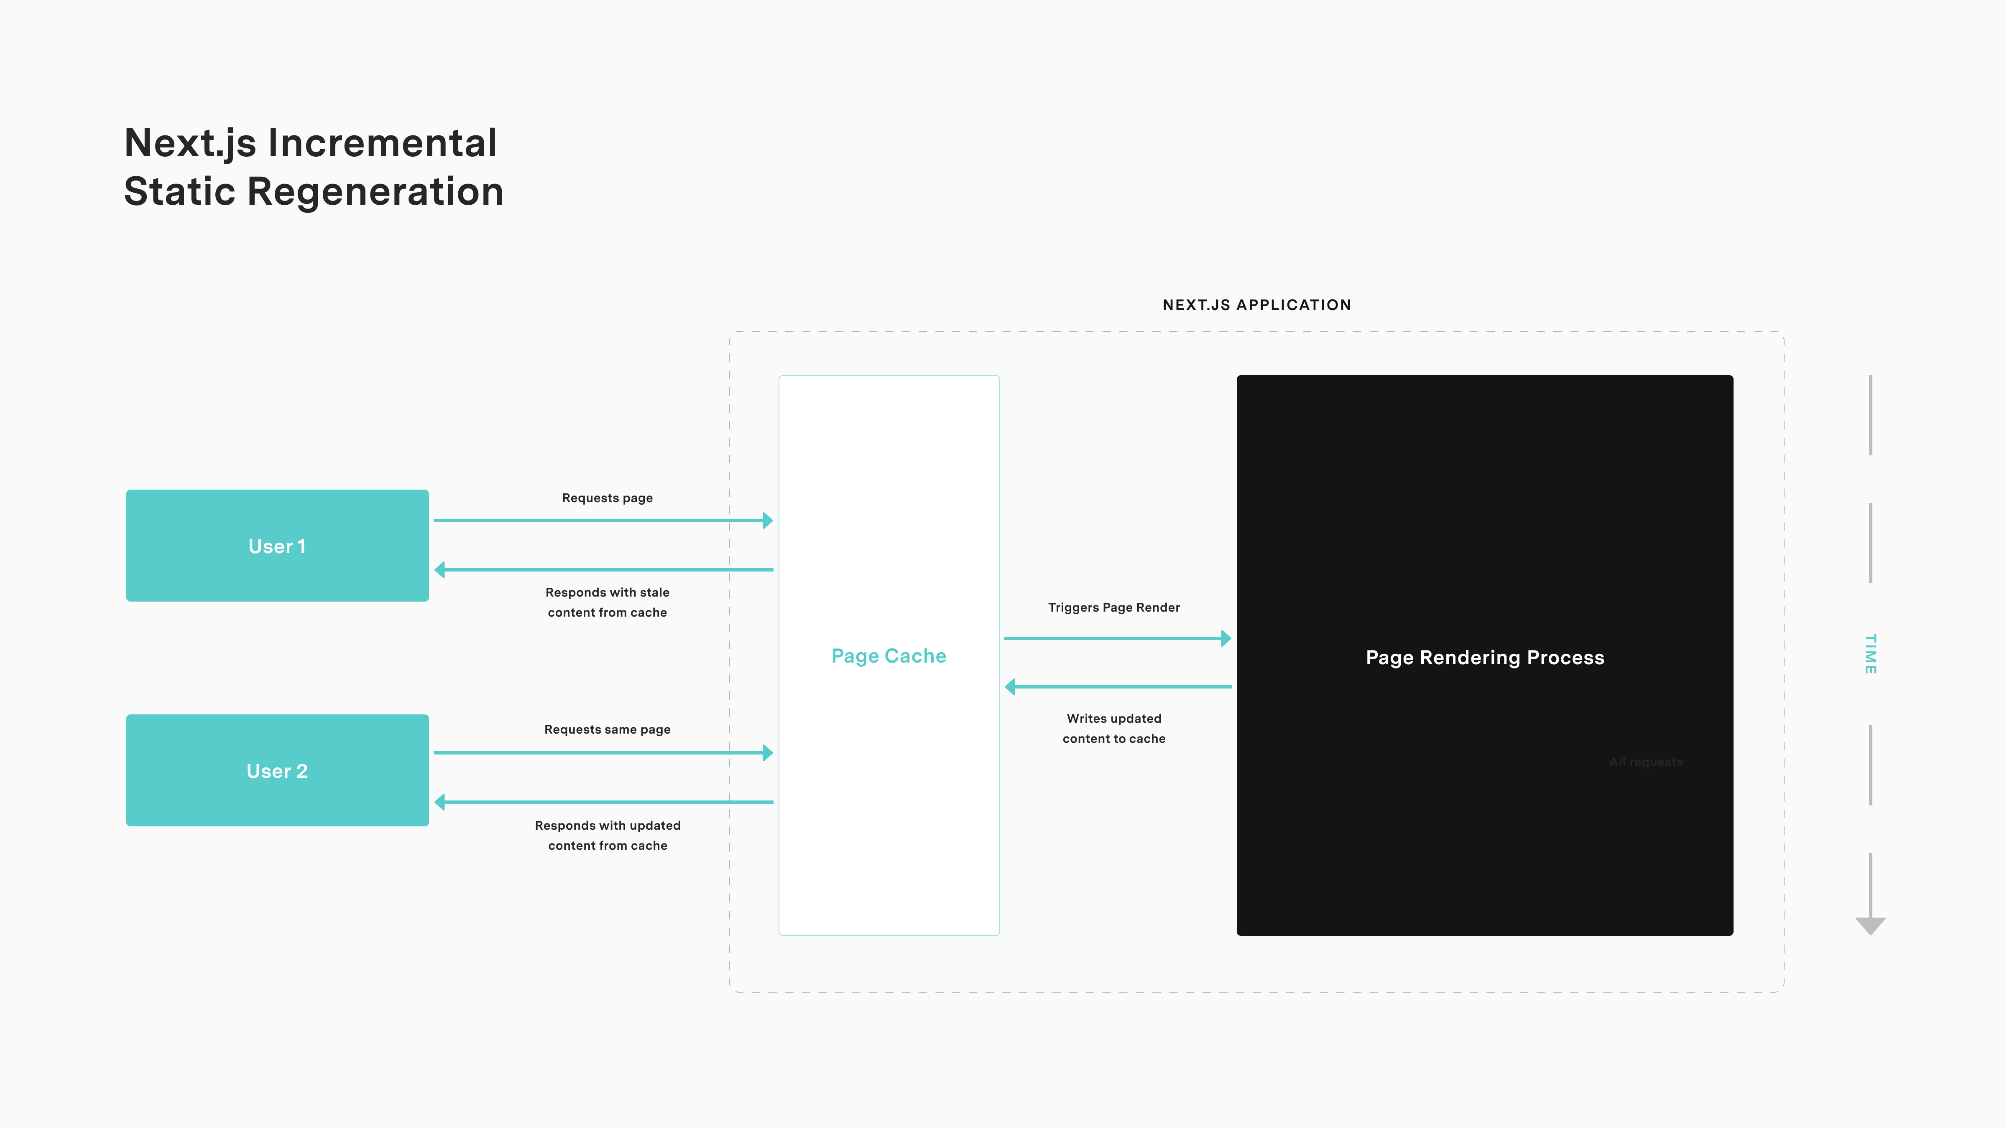

Slide 19
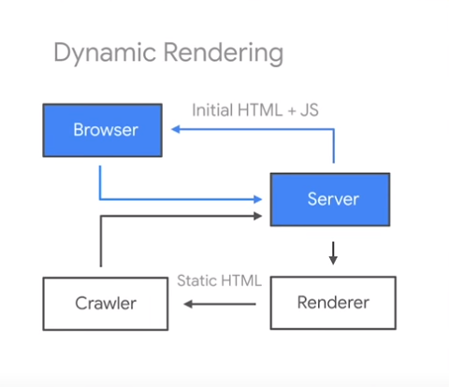

Slide 20
SSR Technologies
Nuxt.js
Angular
Universal
Next.js
React
react-dom/server
Gatsby
Razzle
Remix

Slide 21
Is SSR the Future? Arguments.
The bots will become smarter
No SSR will be required
It is inevitable
SSR is becoming part of the modern web development

Slide 22


Slide 23
Thank you!

Slide 25
Resources
https://dev.to/gopal1996/understanding-reflow-and-repaint-in-the-browser-1jbg
https://www.educative.io/answers/what-is-server-side-rendering
https://kontent.ai/blog/pre-rendered-server-rendered-or-hybrid-which-should-i-use/
https://www.lumar.io/ebooks/javascript-seo-guide/different-rendering-methods/
https://chandulanethmal.github.io/programming/web/Static-Dynamic-Websites/ https://www.botify.com/blog/dynamic-rendering-seo
http://fewgoodengineers.com/SinglePage_app.html
https://web.dev/rendering-on-the-web/
https://www.youtube.com/watch?v=PFwUbgvpdaQ&t=137s&ab_channel=GoogleSearchCentral

